Slide 1

Early Pattern Aware Bayesian Model for Social Content Popularity Prediction
1
1
1
1
2
1
Qitian Wu , Chaoqi Yang , Xiaofeng Gao , Peng He , Guihai Chen
Department of Computer Science and Engineering, Shanghai Jiao Tong University, China
Tencent, Shenzhen, China
1
2
Presenter: Qitian Wu
Notes:
Good afternoon! My name is Qitian Wu, a first-year master student from Shanghai Jiao Tong University. I will give a presentation of my paper, early pattern aware Bayesian model for social content popularity prediction.

Slide 2





Online Social Networks
temporal content status
timeline
#content1
reshare
#content2
reshare
Online social networks provide people with a quick access to information, communication and study.
• Fast Transmission Rate
• Good Timeliness
• Low Dissemination Cost
Notes:
Online social networks, like facebook, twitter, weibo and wechat, play an important roles in our daily lifes and provide people with a quick access to information and communication due to its fast transmission rate, good timeliness and low dissemination cost.

Slide 3
Problem Statement
temporal content status
timeline
observing duration
life duration
With tweets in observing duration, one would like to know how many tweets will be posted in the end.
• rumor monitoring
• personalized recommendation
• anomaly detection
• targeted advertisement
Notes:
On such platforms, users can generate contents that contains information and expose them to their friends. For example, users on Twitter can post tweets about one topic, and their followers could forward the tweets, which would form an information cascade. With tweets in an observing duration, we would like to know how many tweets will be posted in the end. This prediction helps us to estimate the future state at the beginning of one content appearance, and may shed more lights on various practical applications, such as rumor monitoring, personalized recommendation, anomaly detection and targeted advertisement.

Slide 4
Motivation of Present Study
Most previous methods rely on long-term observation
timeline
observing duration
long-term observation
timeline
observing duration
early-stage prediction
Notes:
There are a large number of studies probing into this problem. However, the common limitations of previous works is relying on a long observation time before prediction, like dozens of hours after appearance of one social content. While long observation could provide more observed information and guarantee an accurate prediction, it would deprive the prediction of enough practical significance, since some attractive social contents could get popular and bring up a huge social effect in one or two hours. To this end, we aim to shorten the observation time and target the early-stage prediction problem.

Slide 5
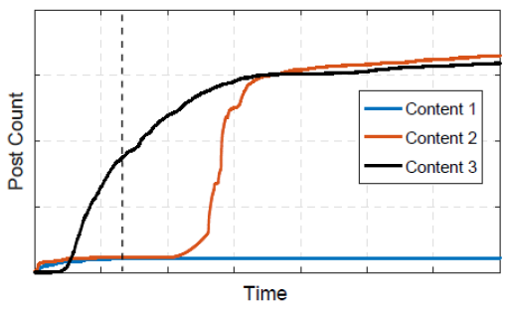
Challenges of Early-Stage Prediction
• some contents with similar early-stage evolution could generate quite different popularity.
• some contents with totally different evolution trends may reach a similar popularity.
Notes:
But the early-stage prediction may bring up several challenges. Firstly, we observe that some contents with similar early-stage evolution could generate quite different popularity in the future. Also, some contents with totally different evolution trends may reach a similar popularity. These observations show that content popularity is hard to predict merely based on early-stage observed series.

Slide 6
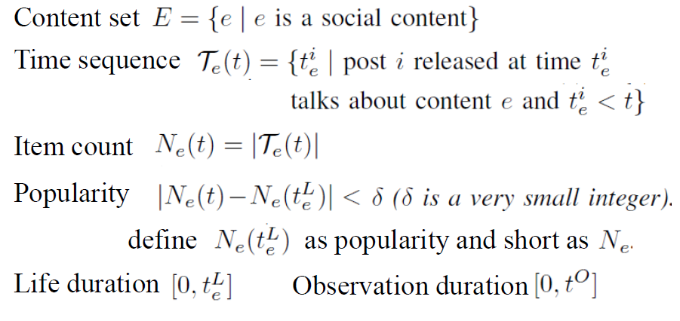
Preliminary
Notes:
Then we define some important notations. We use E to denote the set of social contents, and Te(t) to denote the set of posts that relate to content e and were posted before time t. The Ne(t) denote number of items up to time t. The popularity can be defined as the number of posts before time t, after which very small number of new posts will arrive. And we call teL the life duration, and tO the observation duration.

Slide 7
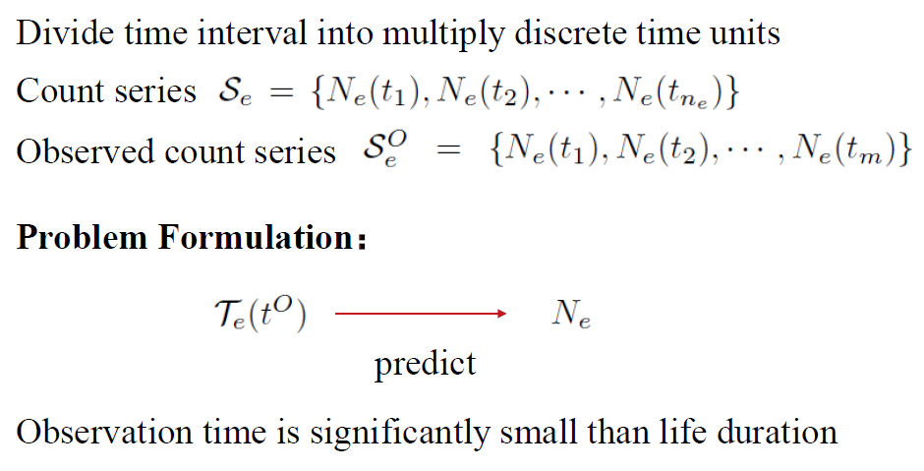
Preliminary
Notes:
We further divide time interval into multiple discrete time units, so we can get a count series and an observed count series that records the post number at each timestamp. The problem can be formulated as given the time sequence of content e up to observation time tO, we would like to predict its final popularity. And we emphasize that the observation time would be significantly small than life duration.

Slide 8
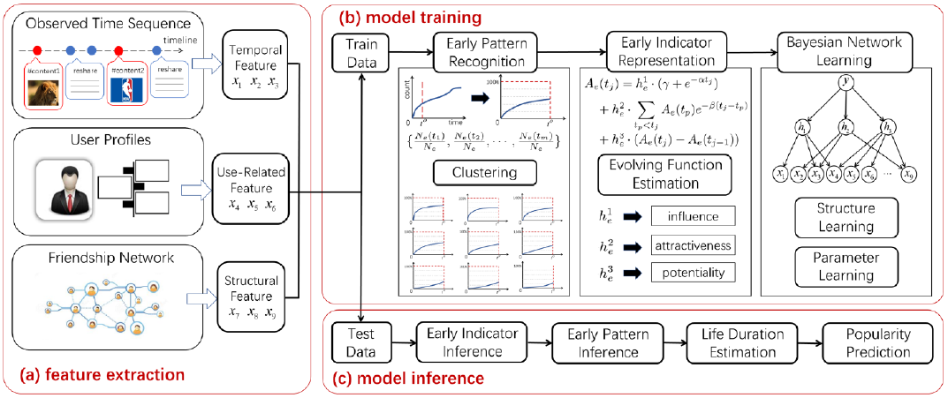
Model Framework
Notes:
To solve the problem, we build a model. The framework includes feature extraction, model training and model inference.

Slide 9
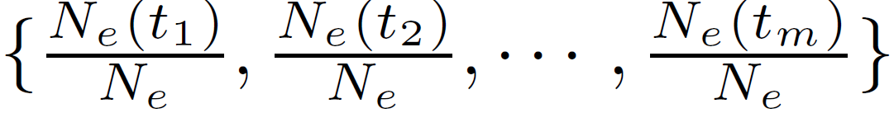
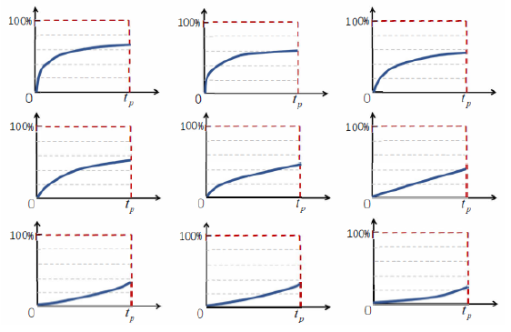
Early Pattern and Features
• Early pattern: count series normalized on popularity
• Use K-means algorithm to cluster contents into groups with similar early patterns
Notes:
We first define a new concept, early pattern, that is the observed count series normalized on popularity. Then we use K-means algorithm to cluster contents into groups with similar early patterns.

Slide 10
Early Pattern and Features
• Extract temporal, user-related, structural features from raw input
very difficult
temporal
sum, changing rate, deviation
fans number, avg. posts per month
early pattern
user-related
structural
retweet length, community number
• Contents in one group have different features (Inhomogeneity), which depicts that early patterns are unpredictable w.r.t early observed features
Notes:
We extract three kinds of features from raw data, including temporal, user-related and structural features. The temporal features include sum, changing rate, standard deviation of post number. The user-related features include fans number, average posts of users per month, and structural features consist of retweet length, community number. However, we find that the values of features tend to be different for contents in one group, which depicts that early patterns are unpredictable w.r.t early observed features.

Slide 11
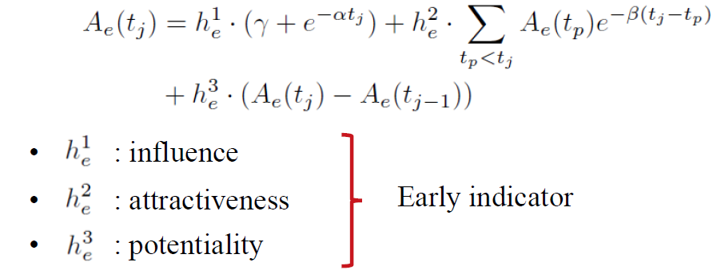
Evolving Function and Early Indicators
• Define an evolving function to characterize the evolution trend:
• These coefficients can bridge the gap between early observation information and future evolution
Notes:
To resolve this, we detour prediction of early pattern, and probe into an evolving function. We use this evolving function to fit the time series and characterize the evolution trend. By this function, we can extract three parts of information, called as early influence, early attractiveness, and early potentiality. We term them as early indicators. These coefficients can bridge the gap between early observed features and future evolution.

Slide 12
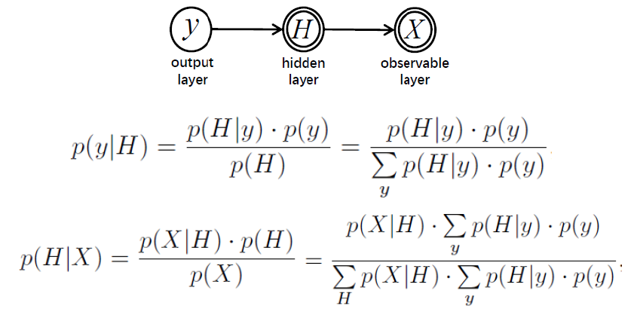
Bayesian Network and Learning
• Adopt Bayesian network to model the relationship among early features, early indicators and early patterns
• Use hill-climbing algorithm to search for optimal structure.
Notes:
We further use Bayesian network to model the relationship among early features, early indicators and early patterns, and use hill-climbing algorithm to search for optimal structure.

Slide 13
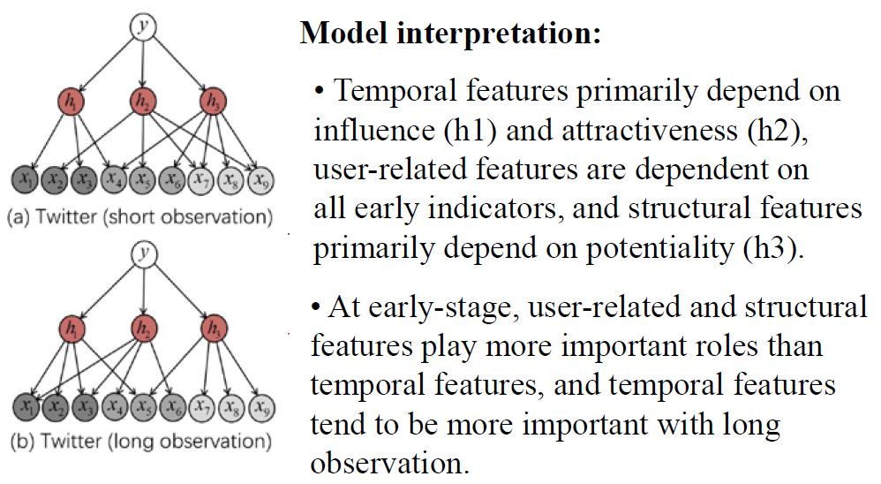
Bayesian Network and Learning
Notes:
This the trained network structure for Twitter dataset. The results show that temporal features primarily depend on early influence and early attractiveness, user-related features are dependent on all early indicators, and structural features primarily depend on potentiality. Moreover, at early stage, user-related and structural features play more important roles than temporal features, and temporal features tend to be more important with long observation.

Slide 14
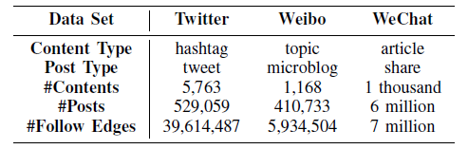
Experiment Setup
• 3 real-world datasets
• 80% data for training, 20% for test
• 1h observation for Twitter and WeChat, 2h for Weibo
• Comparative methods: Hawkes Process [2015], SEISMIC [2015], BEEP [2017], ESP-TAN [2016], LARM [2017], Support Vector Regression
Notes:
We apply our model to three real-world datasets, Twitter, Weibo and WeChat. The WeChat dataset is provided by Tencent. We 80% data for training and the remaining 20% for test. For Twitter and WeChat, we basically consider 1 hour observation, while for Weibo, we consider 2 hour. And we compare our methods with several other state-of-the-arts.

Slide 15
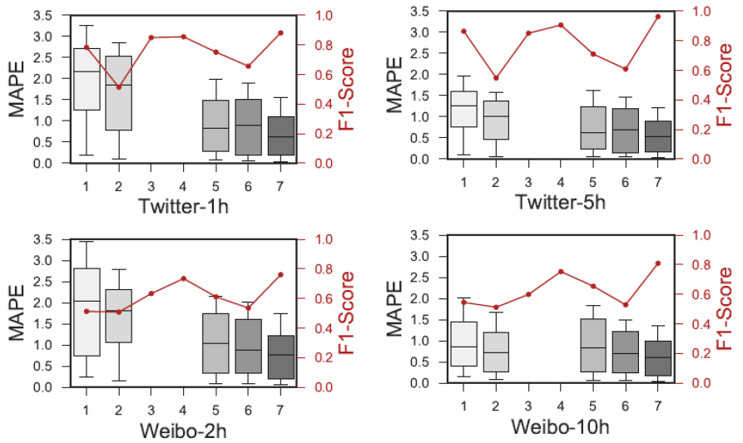
Experiment Results
Notes:
The experiment results show that our method outperforms other competitors for early-stage prediction, and achieve improvement on MAPE and F1-score.

Slide 16
Conclusion
• Problem: early-stage prediction for social content popularity
• Methodologies:
• Construct early pattern and early indicator (evolving function) to better represent early observed information
• Propose a Bayesian network based model to capture the probabilistic relations among early patters, early indicators and early observed features
• Experiments: apply the model to three real-world datasets and verify its superiority over state-of-the-arts
Notes:
The experiment results show that our method outperforms other competitors for early-stage prediction, and achieve improvement on MAPE and F1-score.

Slide 17
Thank you!
Q&A

